Slide 1
Implementation of Measurement-based QoS Mechanism
Software-Defined Networking Lab Project
Group 1: Alperen Gundogan, Ekin Budak, Mustafa Selman Akinci and Sarfaraz Habib
Date: July 9, 2018

Slide 2
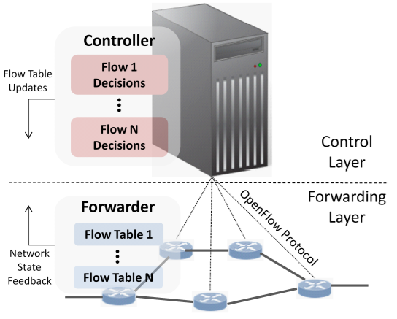
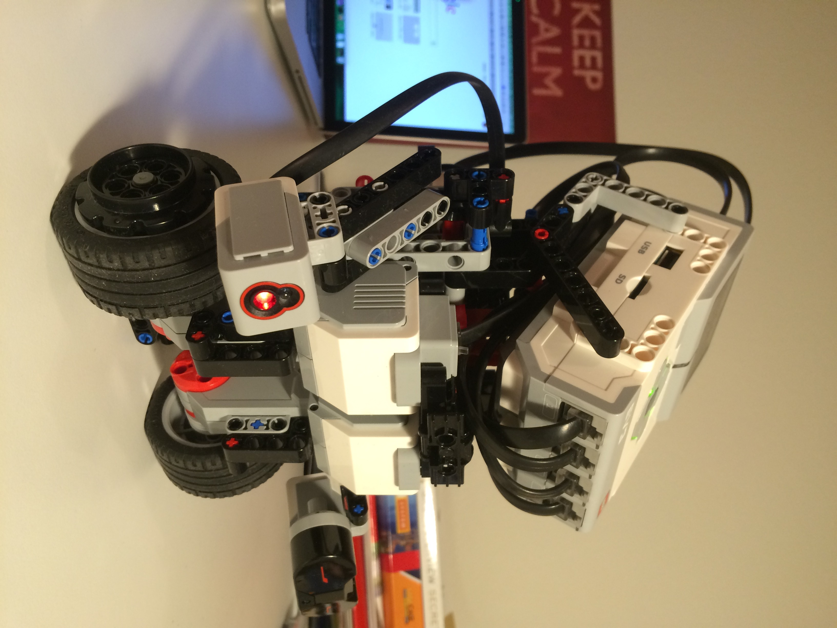
Introduction
SDN approach enables us to monitor live statistics of the network
A self-balancing robot (HOMER) is used for demonstration

Slide 3
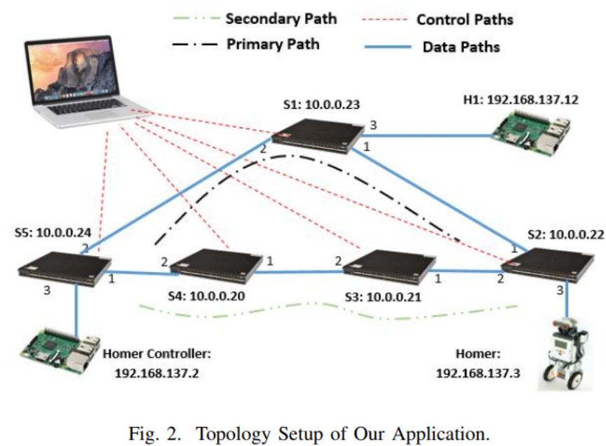
Topology Implementation

Slide 4
Methodology
Flow differentiation
Special Flows
Data Flows
Key aspects of SDN controller in our application:
Topology Management
NetworkX, live discovery of the topology
Route Management
Periodically network state monitoring and congestion measurement
Route Calculation
Shortest path and QoS path
Cost Parameter -> Bandwidth

Slide 5
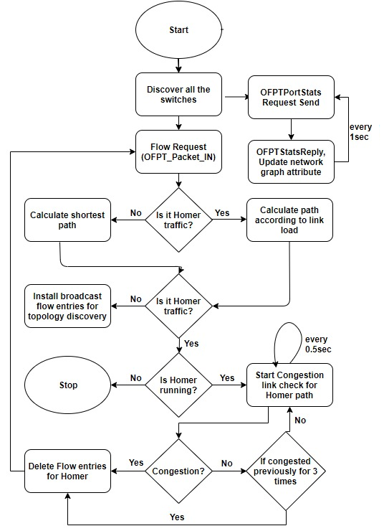
Pseudo Algorithm
Port Stats Request to the switches
Update graph in NetworkX
Route calculated on Src and Dest MAC after OFPT_Packet_IN message
Link Load is used as Metric to calculated route in congestion otherwise Shortest path is used
Homer Link congestion is checked in every 0.5 second
Homer path when previously congested link becomes non-congested in the last three seconds.

Slide 6
Problems?
Multiple times route calculation request.
Solution: Reverse order path installation
Discrete traffic load.
Solution: New metric which accumulates link load
Lost packets, due to the calculation and install time of new route when there is no matching flow in the switches.
Solution: Add new flows with higher priority instead of deleting old path.

Slide 7
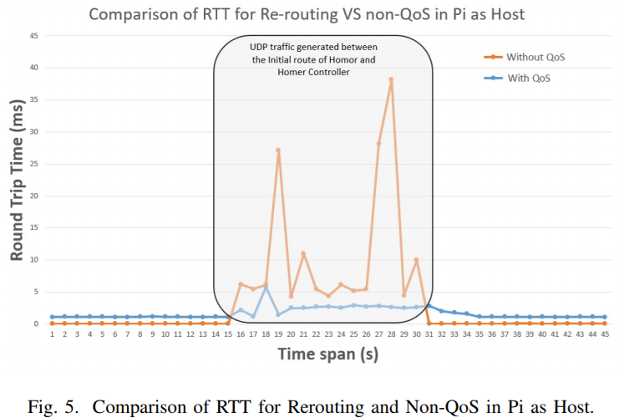
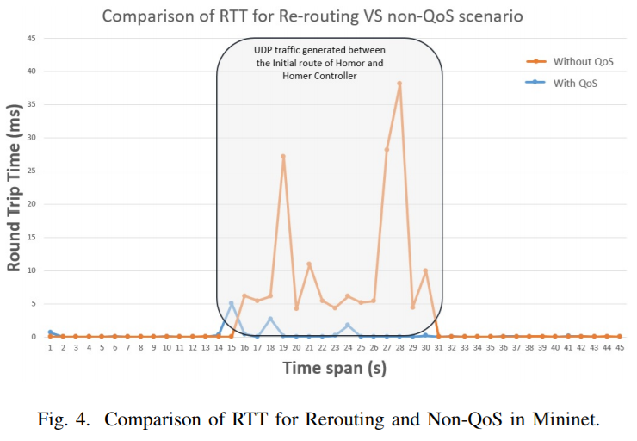
Analysis and Results
Testing Procedure
Ping all hosts for discovery
Ping Homer <-> Homer controller
Generate UDP traffic between a host & Homer Controller
Tested on Mininet Environment
Round Trip Time observed between Homer & Homer Controller
RTT remains the same in congestion
Tested on Hardware with Pis as Hosts
No effect of congestion
Re-routing provides less RTT as depicted by graph

Slide 8
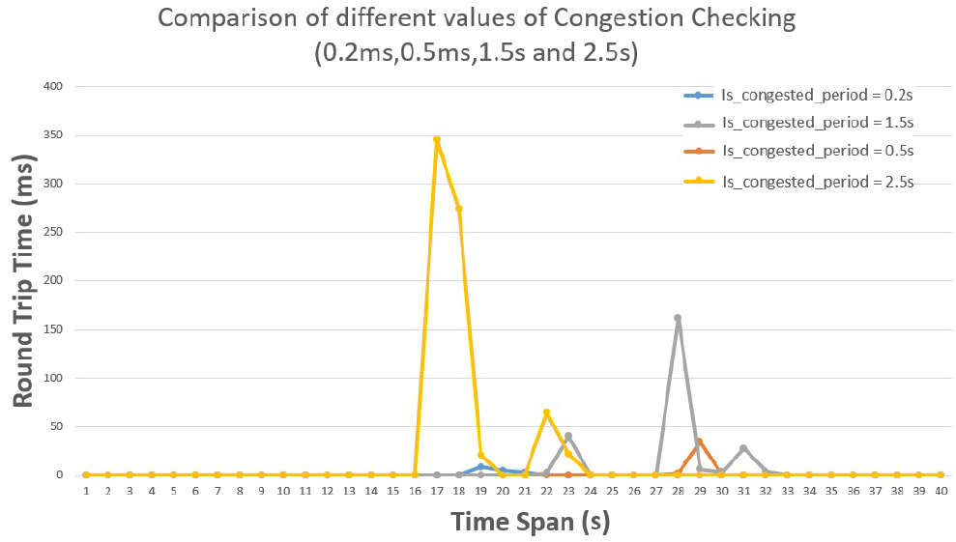
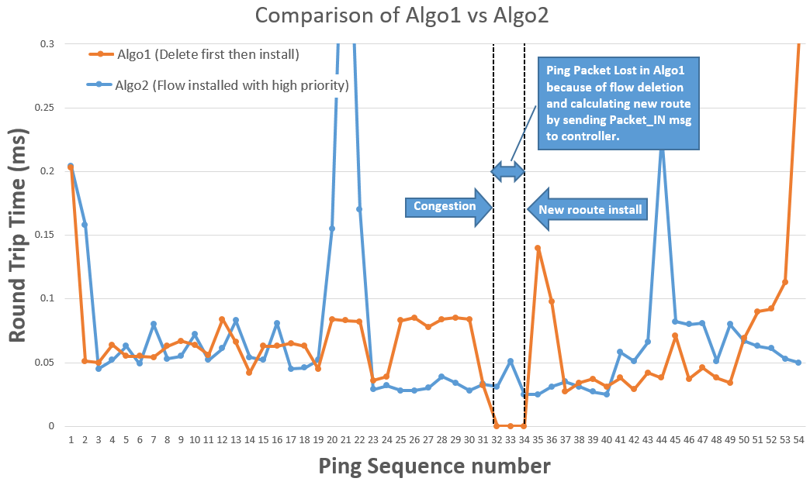
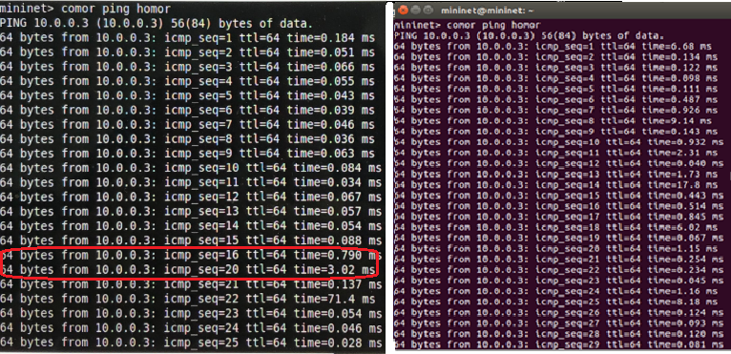
Analysis and Results
Congestion link check period should be lower than the period of Port Stats Request to detect the congestion link before losing QoS
Algo1: After congestion, deleting flow entry for Homer and installing new route by using Packet_IN msg has an adverse effect
Algo2: Installing new flows for Homer with higher priority

Slide 9
Conclusion & Demo
Rerouting performed when congestion is observed on sensitive application‘s path to satisfy QoS requirement
Application is capable of dynamic routing to achieve QoS requirement
SDN is an emerging technology that is likely to revolutionize traditional networking
Final, remark that SDN can be expanded beyond actual match/action paradigm and can actually help internet evolve.

Slide 10
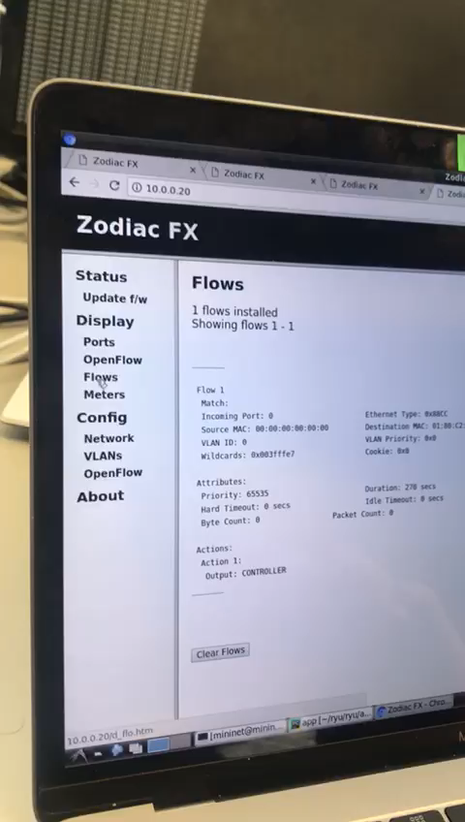
Thank you. Any QuestionS?

